Slide 1

$ git commit -m
"great first impression"
How to Email Your Resume
A Professional Guide for DevOps Engineers
Crafting emails that stand out in recruiter inboxes
$ send --resume
--target hr@company.com
--subject DevOps_Role
CI/CD
AWS
Kubernetes
Terraform
Abhilash Waghmare | Senior DevOps Engineer | Bengaluru

Slide 2




KEY ELEMENTS OF EVERY RESUME EMAIL
Clear Subject Line
Personalized Greeting
Proper Attachments
Professional Signature
Include the role title and your name.
Ex: "DevOps Engineer – Abhilash W."
Address the recruiter by name.
Research to find the right contact.
Attach resume as PDF.
Naming: Abhilash_Waghmare_DevOps_Resume.pdf
Full name, phone, email,
LinkedIn & GitHub profile links.
Slide 2 of 8

Slide 3
SAMPLE EMAIL — Sending Resume to a Recruiter
New Email ● Compose
To:
recruiter@techcorp.com
Subject:
Application for Senior DevOps Engineer – Abhilash Waghmare
Dear [Recruiter Name],
My name is Abhilash Waghmare, and I am applying for the Senior DevOps Engineer role at [Company Name]. My resume is attached to this email.
With 4+ years of experience in AWS, Kubernetes, Terraform, and CI/CD pipeline design, I believe I am a strong match for this role. I have led EKS migrations, automated infrastructure provisioning, and reduced deployment times by 70%.
I would appreciate the opportunity to discuss next steps. You may reach me at +91-9812345678 or abhilash.waghmare@outlook.com.
Warm regards,
Abhilash Waghmare
Slide 3 of 8

Slide 4

SAMPLE EMAIL — Formal Job Application
Introduction & Experience
Enthusiasm & Follow-up
Dear [Recipient's Name],
I am Abhilash Waghmare and I am submitting my application for the DevOps Engineer role. My resume is attached.
I have 4+ years of industry experience in cloud infrastructure, CI/CD pipelines, and Kubernetes orchestration. I have reviewed the job description and am confident I am qualified to excel in this role.
I am excited to apply for this position as it aligns with my expertise in DevOps and cloud automation.
Please feel free to contact me at +91-9812345678 or via email at abhilash.waghmare@outlook.com.
Kindly confirm receipt and inform me of the next steps in the process.
Best regards,
Abhilash Waghmare
Slide 4 of 8

Slide 5
EMAIL COVER LETTER with Attached Resume
01
State Your Purpose
02
Reference Attachments
Applying for Senior DevOps Engineer at [Company]. Express your intent clearly in the opening line.
Please find my resume and cover letter attached as PDFs with professional file names.
03
Highlight Key Points
04
Provide Contact Info
Mention AWS certifications, 4+ years EKS/Terraform experience, and your motivation for this role.
List your phone, email, LinkedIn: linkedin.com/in/abhilash-waghmare and GitHub profile.
Slide 5 of 8

Slide 6




BEST EMAIL TEMPLATE for Sending Your Resume
Subject:
Senior DevOps Engineer Application – Abhilash Waghmare
To:
hr@company.com / recruiter@company.com
Attach Resume: "I have attached my resume for the Senior DevOps Engineer position. File: Abhilash_Waghmare_DevOps_Resume.pdf"
Highlight Qualifications: "My resume details 4+ years of AWS, Kubernetes, Terraform & CI/CD pipeline experience with measurable outcomes."
Show Research: "I've followed [Company]'s cloud-native journey and would be honored to contribute to your platform engineering team."
Request Confirmation: "Please confirm receipt. I look forward to discussing next steps."
Slide 6 of 8

Slide 7





COMMON MISTAKES TO AVOID
Generic Messages
Missing Attachments
Don't copy-paste the same email to every company. Customize each one — mention the specific role, team, or project that excites you.
Always double-check that your resume PDF is attached before sending. Name it professionally: Abhilash_Waghmare_DevOps_Resume.pdf
Typos & Errors
Wrong Timing
Proofread every email. A spelling mistake in a technical role application raises serious red flags with hiring managers.
Send emails on Tue–Thu between 9am–11am for best open rates. Avoid Monday mornings and Friday afternoons.
Pro Tip: Send emails on Tuesday–Thursday between 9am–11am for the best recruiter response rates.

Slide 8
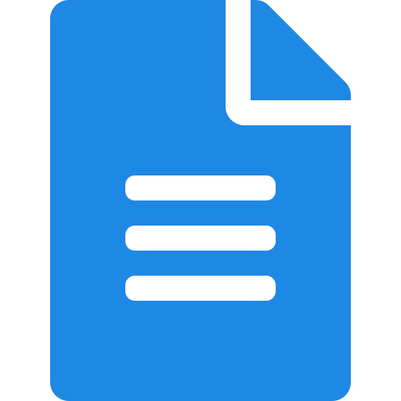



YOUR PATH TO SUCCESS
01
02
03
04
Craft Your Message
Review & Refine
Send with Confidence
Follow Up
Choose the right template and tailor it to each role and company.
Proofread carefully and confirm your resume PDF is attached.
Hit send on Tue–Thu morning, knowing you've presented yourself professionally.
If no reply after one week, send a polite, concise follow-up email.
Good luck with your job search, Abhilash! 🚀 You've got this.

